Slide 1
Data Structures and Algorithms IICT-6005
Lesson 5 – Theoretical Analysis

Slide 2
Lesson Content
Primitive operations
Counting algorithm operations
Algorithm time as a function
Asymptotic notation
Complexity classes

Slide 3
Theoretical Analysis
In determining the efficiency of an algorithm, one can note that:
The running time of an algorithm or a data structure method typically grows with the input size (n), although it may also vary for different inputs of the same size.
The running time is affected by a lot of factors, such as the hardware environment and the software environment.
Ideally, measure the efficiency for algorithms by focusing on the relationship between the running time of an algorithm and the size of its input.
The algorithm's running time should be categorized as a function f(n) of the input size n making it independent of environmental factors.

Slide 4
Primitive Operations
A function of the input size f(n) expressing the algorithm’s running time in terms of the size of the problem can be obtained by counting the total amount of Primitive Operations carried out by the algorithm.
Primitive operations are basic computations performed by an algorithm.
Examples are evaluating an expression, assigning a value to a variable, indexing into an array, calling a method, returning from a method, etc.
They are easily identifiable in pseudocode and largely independent from the programming language.

Slide 5
Counting Algorithm Operations
Find the Maximum
1. m = X[0] 1
2. k = 1 1
3. while (k < n) { n
4. if (X[k] > m) { n - 1 5. m = X[k] } A
6. k++ } n - 1 7. return m 1
Total time
T(n) = A + n + n - 1 + n - 1 + 1 + 1 + 1
T(n) = A + n + n - 1 + n - 1 + 1 + 1 + 1 T(n) = A + 3n + 1

Slide 6
Counting Algorithm Operations
An algorithm may run faster for some inputs and consequently slower for other types of input sizes.
This is because for certain input sizes, primitive operations in conditional statement may not require execution or iterations will only have a single (or no) repetition.
Hence, when expressing the running time of an algorithm as a f(n) we also have to think about the Worst Case and Best Case Scenario!
The Worst Case analysis is of particular concern as it is important to know how much time might be needed in the worst case to guarantee that the algorithm would always finish on time.
The Best Case performance, on the other hand, indicates the way an algorithm behaves under optimal conditions.

Slide 7
Counting Algorithm Operations
Find the Maximum
Best Case Maximum Number is found Immediately at X[0]
1. m = X[0] 1
2. k = 1 1
3. while (k < n) { n
4. if (X[k] > m) { n-1 5. m = X[k] } A = 0 (never occurs no number > X[0])
6. k++ } n-1 7. return m 1
Total time, T(n) = A + 3n + 1
T(n) = 0 + 3n + 1
T(n) = 3n+1

Slide 8
Counting Algorithm Operations
Find the Maximum
Worst Case Maximum Number is at X[n-1] i.e. last element
1. m = X[0] 1
2. k = 1 1
3. while (k < n) { n
4. if (X[k] > m) { n-1 5. m = X[k] } A = n-1 (happens every time)
6. k++ } n-1 7. return m 1
Total time, T(n) = A + 3n + 1
T(n) = n - 1 + 3n + 1
T(n) = 4n

Slide 9
Asymptotic notation
The functions obtained through Theoretical Analysis of these algorithms also describe the Log-Log Graphs produced from Empirical Analysis.
It is possible to separate these functions into groups, according to the growth of their time (and space) requirements and determine which functions have the same growth rate.
Asymptotic Analysis is a well-defined way to separate these functions that corresponds to the same heuristic by computing the running time of any operation in mathematical units of computation.

Slide 10
Asymptotic notation
In Asymptotic Notation, the focus in on the growth rate of the algorithm as it’s input size (n) increases, the less significant terms and the constant coefficients are dropped from the functions obtained from Theoretical Analysis.
We only take into consideration the highest value of n in the function!
Therefore :
T(n) = 4n
…….drops the constant 4 and only takes into consideration n
T(n) = A + 3n + 1
…….drops the constants 3 & 1 and the less significant term A
and only takes into consideration n
T(n) = 6n² + 100n + 300
…….drops the constants 6, 100 & 300 and the less significant value of n
and only takes into consideration n²
Notes:
This allows the analysis to be more manageable as we focus on what is most important and ignore details that complicate our understanding of how the time taken relates to the size of the problem.

Slide 11
Asymptotic notation
The following are used asymptotic notations commonly used to calculate the running time complexity of an algorithm:
Big Ο Notation → O(f(n))
Big Omega Notation → Ω (f(n))
Big Theta Notation → θ(f(n))
These notations provide an easy way of expressing:
Best Case − Minimum time required for program execution.
Average Case − Average time required for program execution.
Worst Case − Maximum time required for program execution

Slide 12
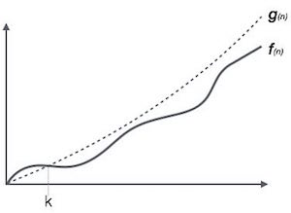
Asymptotic notation
Big O Notation
Ο(n) is the formal way to express the upper bound of an algorithm's running time.
It measures the worst case time complexity or the longest amount of time an algorithm can possibly take to complete
This means that if f(n) is the function representing the running time of the worst case scenario for an algorithm, then, the running time of an algorithm expressed as the function g(n) can be either as fast or faster than f(n).

Slide 13
Asymptotic notation
Big O Notation
To find O(n) for an algorithm :
Find the worst case number of primitive operations executed as a function of the input size.
Express this function with the Big-Oh notation
Disregard any constants or less significant terms
Example:
For the previous algorithm to find the maximum number in an array, we know that the Worst Case Scenario returns the function T(n) = 4n
Therefore Big O of f(n) is O(4n) → O( 4 n)…therefore O(n)

Slide 14
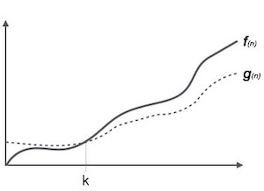
Asymptotic notation
Big Omega Notation
Ω(n) is the formal way to express the lower bound of an algorithm's running time.
It measures the best case time complexity or the shortest amount of time an algorithm can possibly take to complete
This means that if f(n) is the function representing the running time of the best case scenario for an algorithm, then, the running time of an algorithm expressed as the function g(n) can be either as fast as or slower than f(n).

Slide 15
Asymptotic notation
Big Omega Notation
To find Ω (n) for an algorithm :
Find the best case number of primitive operations executed as a function of the input size.
Express this function with the Big-Omega notation
Disregard any constants or less significant terms
Example:
For the previous algorithm to find the maximum number in an array, we know that the Best Case Scenario returns the function T(n) = 3n+1
Therefore Big Ω of f(n) is Ω (3n+1) → Ω( 3 n + 1 )…therefore also Ω (n)

Slide 16
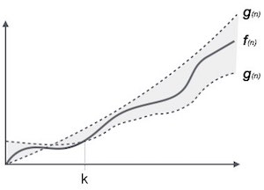
Asymptotic notation
Big Theta Notation
θ(n) is the formal way to express both the lower bound and the upper bound of an algorithm's running time.
This means that if g(n) are functions representing the running time of the best case scenario and worst case scenario for an algorithm, then, the running time of an algorithm expressed as the function f(n) can be either as slow as the Upper Bound g(n), as fast as the Lower Bound g(n) or anywhere in between as demonstrated by f(n).

Slide 17
Asymptotic notation
Big Omega Notation
To find θ (n) for an algorithm :
Find the total number of primitive operations executed as a function of the input size.
Express this function with the Big-Theta notation
Disregard any constants or less significant terms
Example:
For the previous algorithm to find the maximum number in an array, we know that counting the total number of primitive operations returns the function T(n) = A + 3n + 1
Therefore Big θ of f(n) is θ (A+3n+1) → θ(A + 3 n + 1 )…therefore also θ (n)

Slide 18
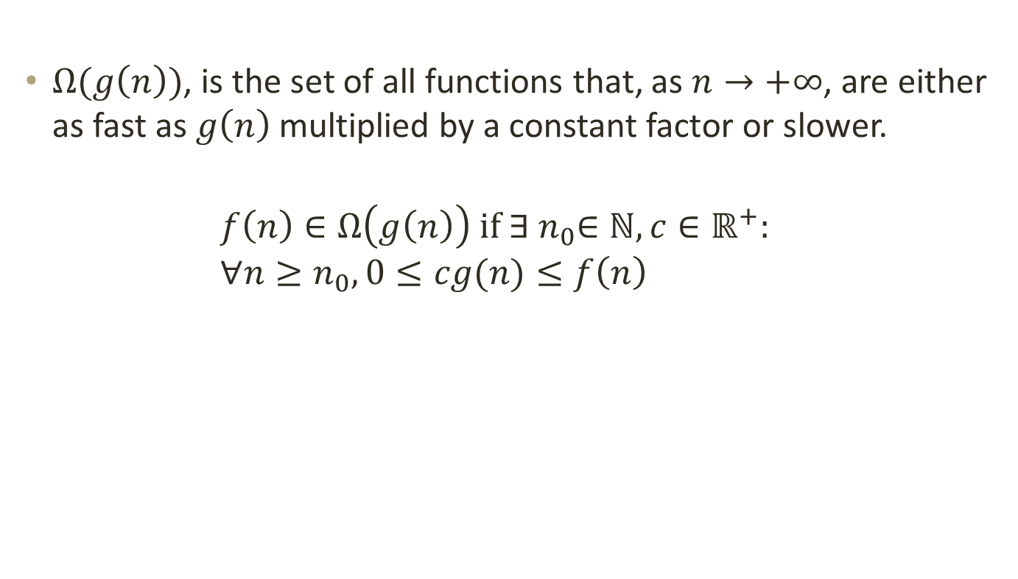
Asymptotic notation
$Ω(g\left(n\right))$, is the set of all functions that, as $n→+∞$, are either as fast as $g\left(n\right)$ multiplied by a constant factor or slower.
$$f\left(n\right)∈Ω\left(g\left(n\right)\right) if ∃{ n}_{0}∈ℕ, c∈ℝ^{+}: \\ ∀n≥n_{0},0≤cg(n)≤f\left(n\right)$$

Slide 19

Complexity classes
$Using Aysmptotic Notation (O or Θ)$ functions can be separated into different groups depending on their growth rate.
These groups are known as Order of Complexities.
The following is a list of Order of Complexities starting from the fastest first
constant | − | Ο(1)
logarithmic | − | Ο(log n)
linear | − | Ο(n)
Log-Linear | − | Ο(n log n)
quadratic | − | Ο(n²)
cubic | − | Ο(n³)
polynomial | − | n^{Ο(k)}
exponential | − | 2^{Ο(n)}

Slide 20
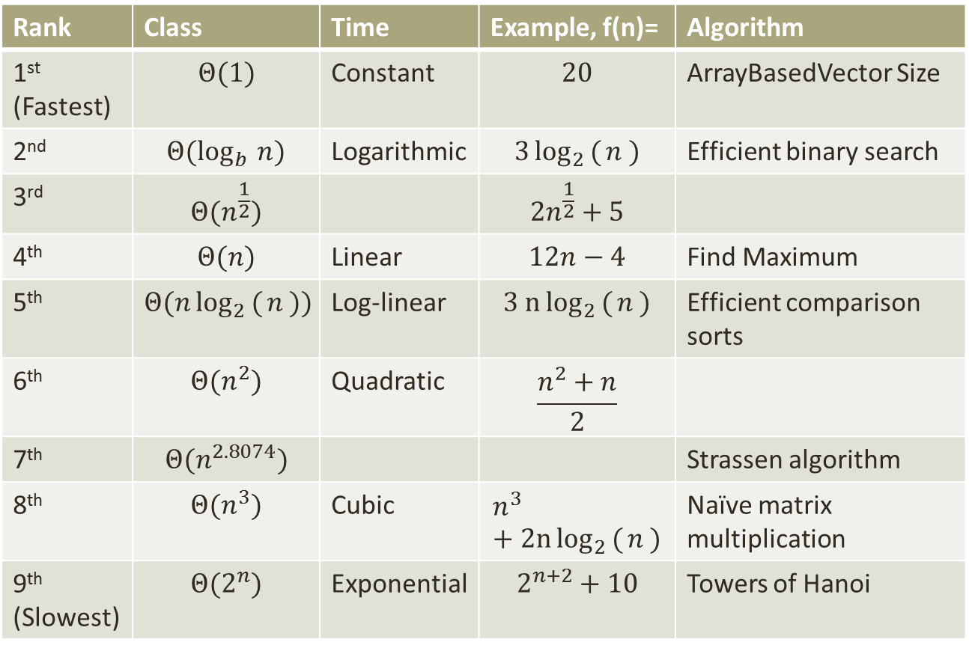
Complexity classes
Rank | Class | Time | Example, f(n)= | Algorithm
1st (Fastest) | $$Θ(1)$$ | Constant | $$20$$ | ArrayBasedVector Size
2nd | $$Θ(\log_{b }{n})$$ | Logarithmic | $$3\log_{2 }({n )}$$ | Efficient binary search
3rd | $$Θ(n^{\frac{1}{2}})$$ |  | $$2n^{\frac{1}{2}}+5$$
4th | $$Θ(n)$$ | Linear | $$12n−4$$ | Find Maximum
5th | $$Θ(n\log_{2 }({n )})$$ | Log-linear | $$3 n\log_{2 }({n )}$$ | Efficient comparison sorts
6th | $$Θ(n^{2})$$ | Quadratic | $$\frac{n^{2}+n}{2}$$
7th | $$Θ(n^{2.8074})$$ |  |  | Strassen algorithm
8th | $$Θ(n^{3})$$ | Cubic | $$n^{3}+2n\log_{2 }({n )}$$ | Naïve matrix multiplication
9th (Slowest) | $$Θ(2^{n})$$ | Exponential | $$2^{n+2}+10$$ | Towers of Hanoi

Slide 21
Summary
Primitive operations
Counting algorithm operations
Algorithm time as a function
Asymptotic notation
Complexity classes

Slide 22
End of lesson
Any questions?

